Slide 1
Basics of Computer Graphics

Slide 2
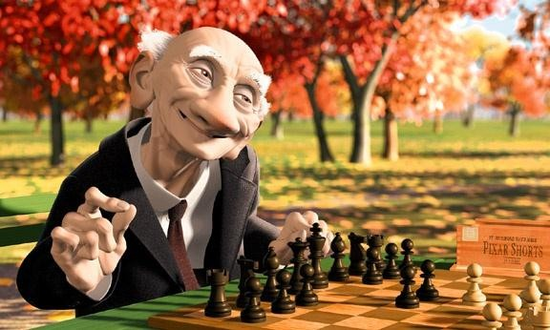

Computer Graphics is about animation (films)

Slide 3
Computer graphics
It is the creation and manipulation of graphic images by means of a computer.
Computer graphics started as a technique to enhance the display of information generated by a computer.
This ability to interpret and represent numerical data in pictures has significantly increased the computer’s ability to present information to the user in a clear and understandable form.
Large amount of data are rapidly converted into bar charts, pie charts, and graphs.

Slide 4
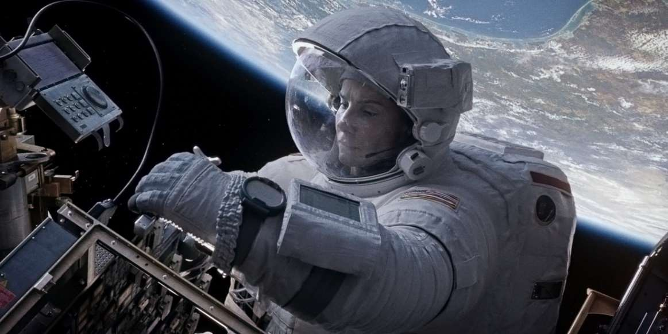
Why bother with CG?
3
All visual computer output depends on CG
printed output (laser/ink jet/phototypesetter)
monitor (CRT/LCD/OLED/DMD)
all visual computer output consists of real images generated by the computer from some internal digital image
Much other visual imagery depends on CG
TV & movie special effects & post-production
most books, magazines, catalogues, brochures, junk mail, newspapers, packaging, posters, flyers

Slide 5


What is a (digital) image?
A digital photograph? (“JPEG”)
A snapshot of real-world lighting?
From computing perspective (discrete)
Image
From mathematical perspective (continuous)
2D array of pixels
2D function
•To represent images in memory
•To express image processing as a mathematical problem
•To create image processing software
•To develop (and understand) algorithms
7

Slide 6
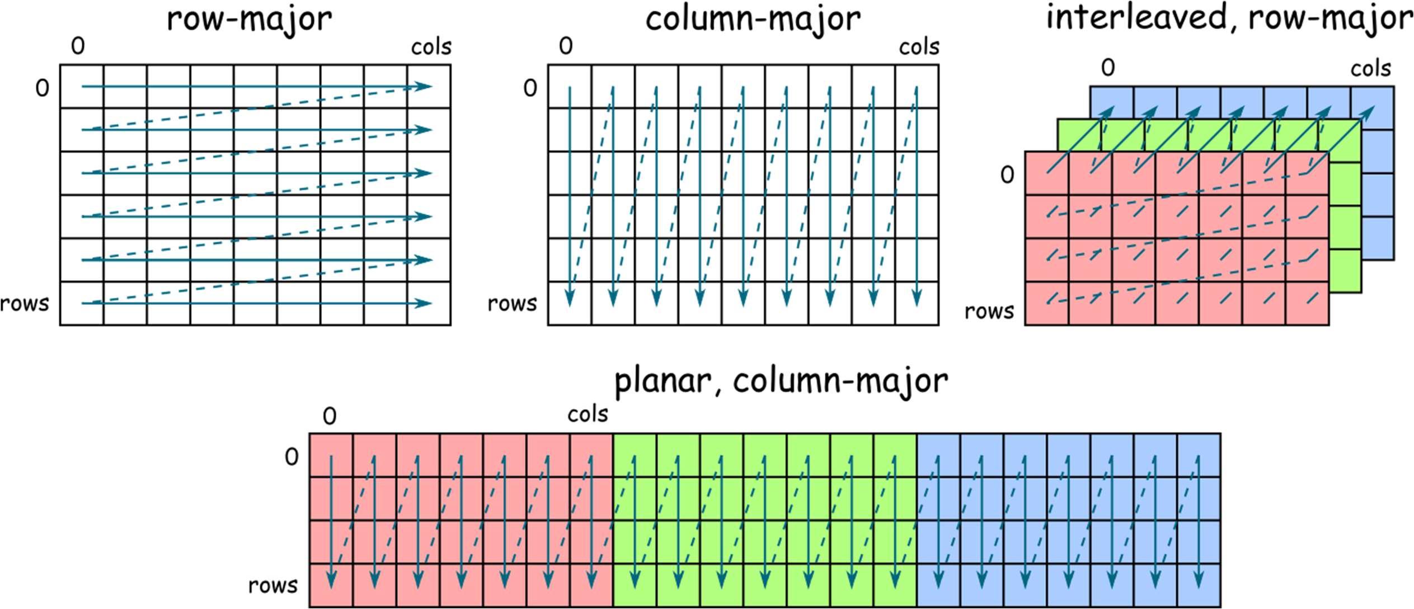
Image
✦ 2D array of pixels
✦ In most cases, each pixel takes 3 bytes: one for each red, green and blue
✦ But how to store a 2D array in memory?
8

Slide 7
Pixel (PIcture ELement)
Each pixel (usually) consist of three values describing the color
(red, green, blue)
For example
(255, 255, 255) for white
(0, 0, 0) for black
(255, 0, 0) for red
Why are the values in the 0-255 range?
✦
12

Slide 8
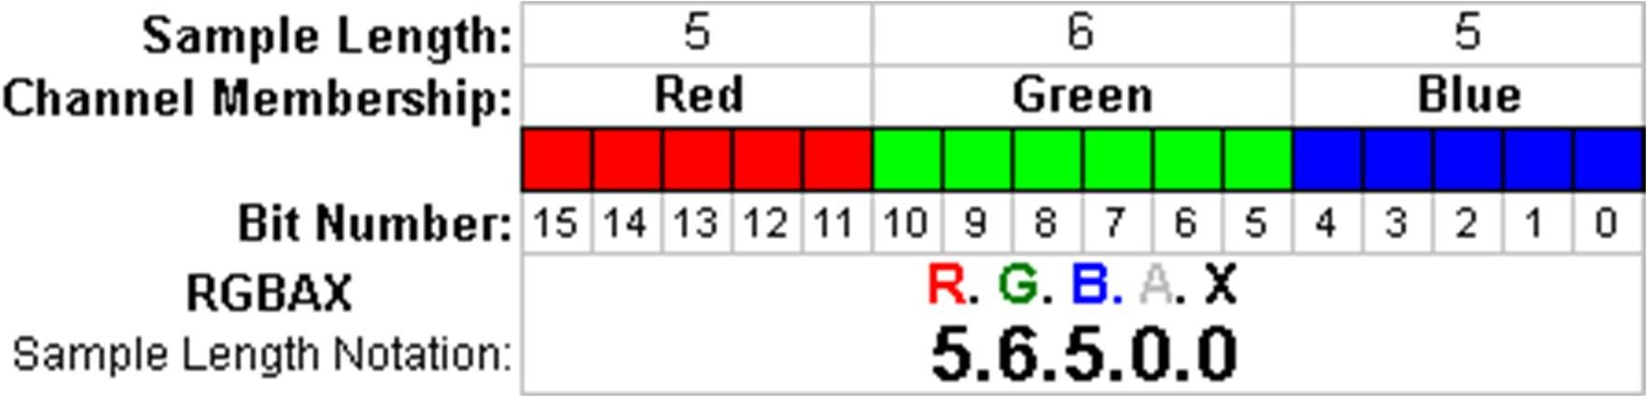
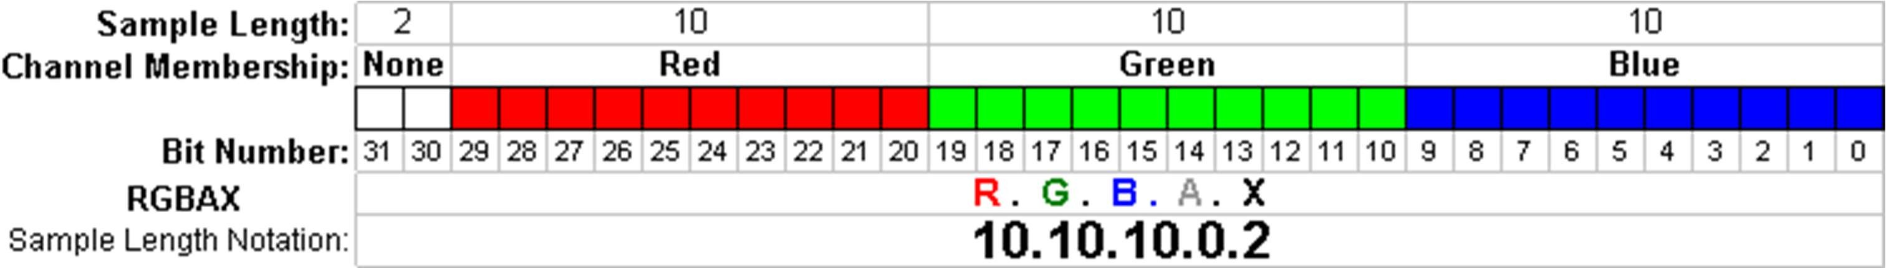
Pixel formats, bits per pixel, bit-depth
Grayscale – single color channel, 8 bits (1 byte)
Highcolor – 2¹⁶=65,536 colors (2 bytes)
Truecolor – 2²⁴ = 16,8 million colors (3 bytes)
Deepcolor – even more colors (>= 4 bytes)
But why?
13

Slide 9
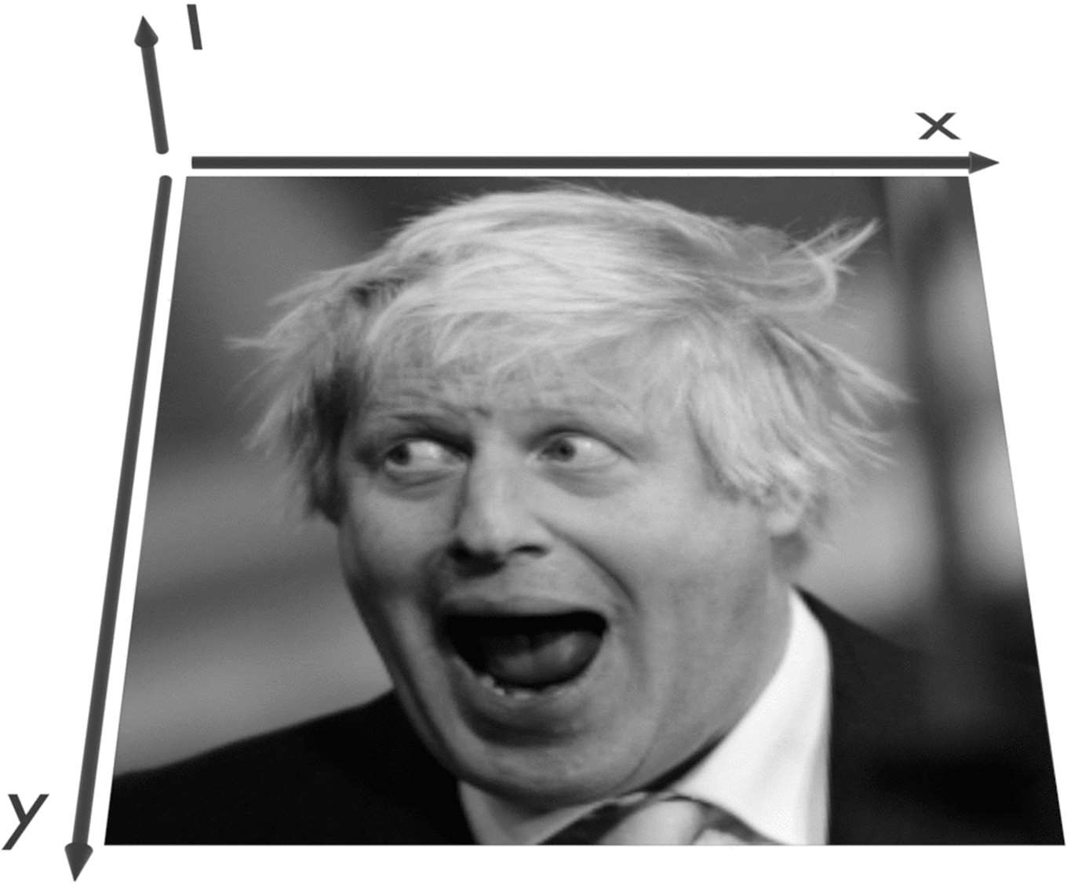
Image – 2D function
Image can be seen as a function I(x,y), that gives intensity value for any given coordinate (x,y)
16

Slide 10
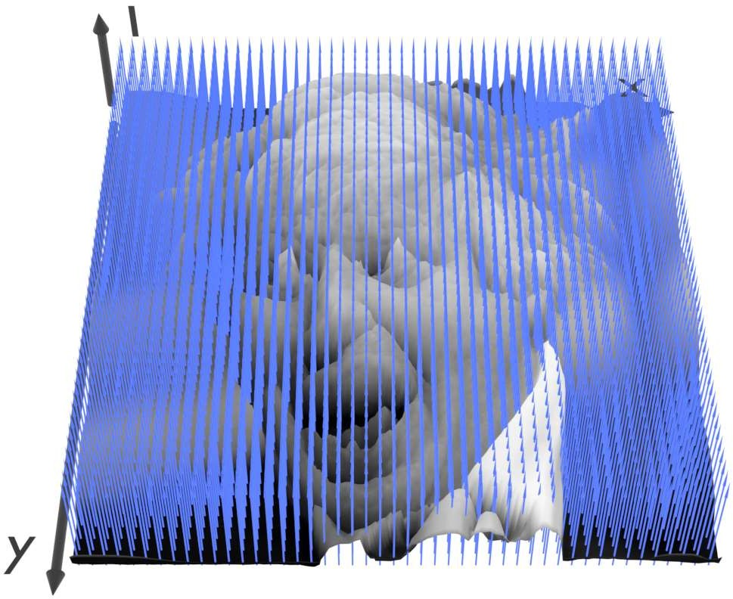
Sampling an image
The image can be sampled on a rectangular sampling grid to yield a set of samples. These samples are pixels.
17

Slide 11
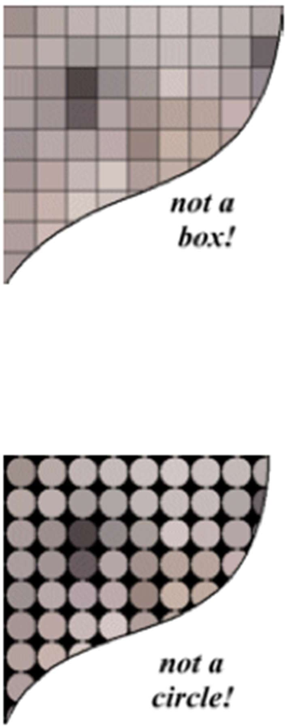
What is a pixel? (math)
A pixel is not
a box
a disk
a teeny light
A pixel is a point
it has no dimension
it occupies no area
it cannot be seen
it has coordinates
A pixel is a sample
18
From: http://groups.csail.mit.edu/graphics/classes/6.837/F01/Lecture05/lecture05.pdf

Slide 12
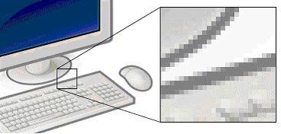
Pixel (picture element)
a pixel is the smallest piece of information in an image.
Pixels are normally arranged in a regular 2D grid, and are often represented using dots or squares.

Slide 13
Pixel (picture element)
Each pixel is a sample of an original image, where more samples typically provide a more accurate representation of the original.
The intensity of each pixel is variable; in color systems, each pixel has typically three or four components such as red, green, and blue, or cyan, magenta, yellow, and black.

Slide 14
Let’s Learn some terminology
http://preservationtutorial.library.cornell.edu/tutorial/intro/intro-01.html

Slide 15
Resolution
The number of pixels per unit length is referred to as the resolution of the image
Based on this resolution only the effect of picture appears on screen.
In other words greater the resolution greater will be the clarity of picture. That is resolution value is directly proportional to clarity of picture.

Slide 16
Actual resolution is determined by the video controller.
Most monitors can operate at several different resolutions.
They are
640 X 480
800 X 600
1024 X 768
1152 X 864
1280 X 1024
Q) A 3 x 2 inch image at a resolution of 300 pixels per inch would have a total pixels of?

Slide 17
Image Resolution: It refers to pixel spacing. In
normal PC monitor it ranges between 25 to 80 pixels per inch.
Screen Resolution: It is the number of distinct pixels in each dimension that can be displayed.
For example, a computer with a display resolution of 1280 x 768 will produce a maximum of 98,3040 pixels on a display screen. Each pixel has a unique logical address, a size of eight bits or more and, in most high-end display devices, the ability to project millions of different colors.

Slide 18
Applications of Computer Graphics
Computer graphics user interfaces (GUIs) − A graphic, mouse-oriented paradigm which allows the user to interact with a computer.
Business presentation graphics − "A picture is worth a thousand words".
Cartography − Drawing maps.
Weather Maps − Real-time mapping, symbolic representations.
Satellite Imaging − Geodesic images.

Slide 19
Photo Enhancement − Sharpening blurred photos.
Medical imaging − MRIs, CAT scans, etc. - Non-invasive internal examination.
Engineering drawings − mechanical, electrical, civil, etc. - Replacing the blueprints of the past.
Architecture − Construction plans, exterior sketches - replacing the blueprints and hand drawings of the past.
Art − Computers provide a new medium for artists.
Entertainment − Movies and games.
Simulation and modeling − Replacing physical modeling and enactments

Slide 20
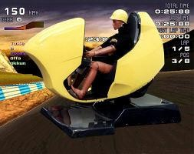
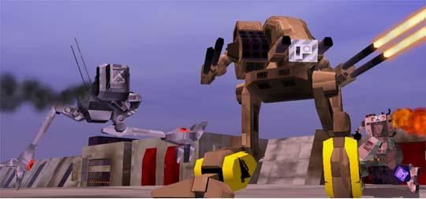
Applications
Entertainment
More vivid
Move exciting
More attractive

Slide 21

Applications (Cont’d)
Medicine
Practice performing surgery.
Perform surgery on a remote patient.
Teach new skills in a safe, controlled environment.

Slide 22
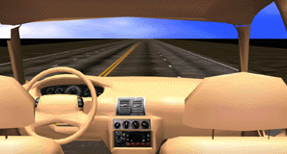
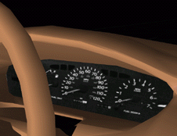
Applications (Cont’d)
Manufacturing
Easy to modify
Low cost
High efficient

Slide 23
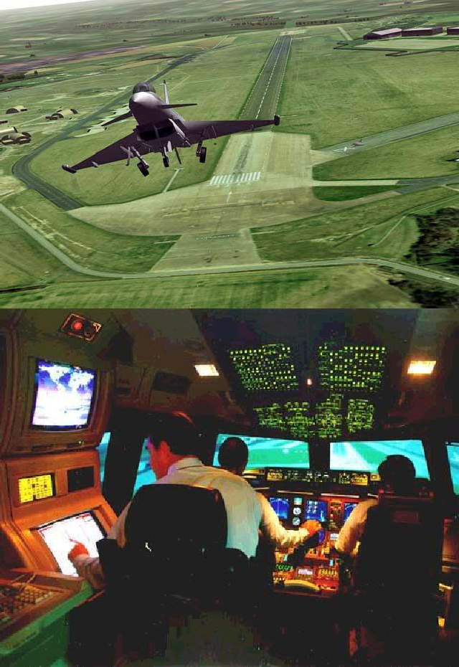
Applications (Cont’d)
Education & Training
Driving simulators.
Flight simulators.
Ship simulators.
Tank simulators.

Slide 24
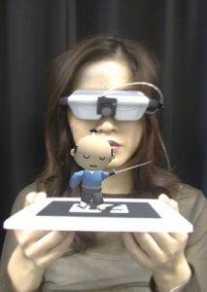
What Is Augmented Reality (AR)?
A combination of
a real scene viewed by a
user and
a virtual scene generated by a computer that augments the scene with additional information.
ARToolkit demo movie
T-immersion 2004 video

Slide 25
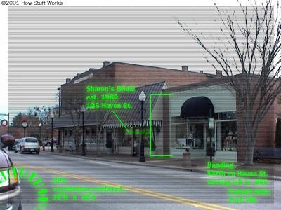
What is AR? (cont.)
Ronald Azuma defines an augmented reality system as one that:
Combines real and virtual world aspects
Is interactive in real-time
Is registered in three dimensions

Slide 26
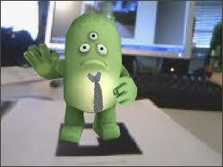
Virtual Reality vs. Augmented Reality
Virtual Reality (VR)
a computer generated, interactive, 3D environment in which a person is immersed : virtual, interactive and immersive
Augmented Reality (AR)
Supplements the real world with the virtual(computer generated) objects that appear to coexist in the same space as the real world.

Slide 27
Augmented Reality vs. Virtual Reality
Augmented Reality
System augments the real world scene
User maintains a sense of presence in real world
Needs a mechanism to combine virtual and real worlds
Hard to register real and virtual
Virtual Reality
Totally immersive environment
Senses are under control of system
Need a mechanism to feed virtual world to user
Hard to make VR world interesting

Slide 28
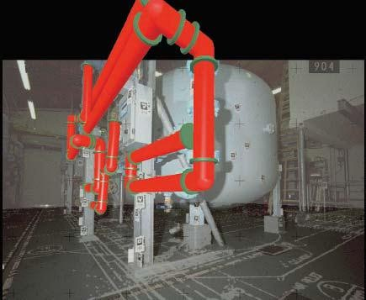
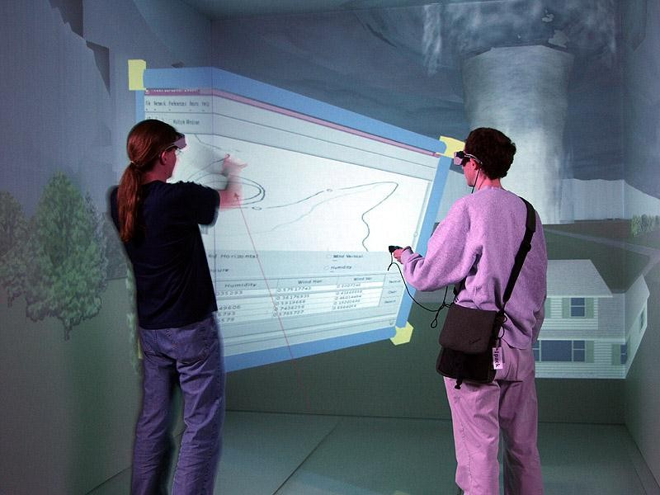
Augmented Reality vs. Virtual Reality
Engineering Education –Virtual Storm

Slide 29
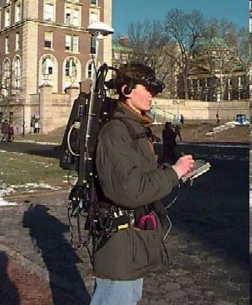
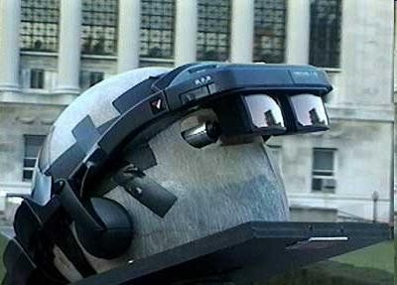
What is needed?
There are three components needed in order to make an augmented-reality system work:
Head-mounted display
Tracking system
Mobile computing power

Slide 30
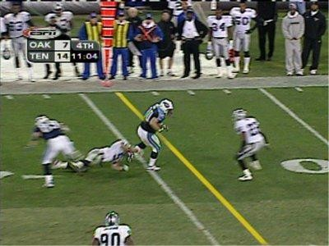
Current Uses of AR
Yellow first down line used on TV broadcasts of football games:
Real world elements: football field and players
Virtual element: the yellow line drawn over the image by computers in real-time

Slide 31
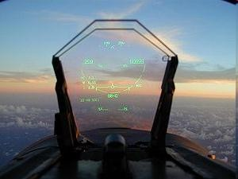
Current Uses of AR
HUD (Head Up Display):
Used in commercial aircraft, automobiles, and other applications
Presents data without requiring the user to look away from his or her usual viewpoint

Slide 32
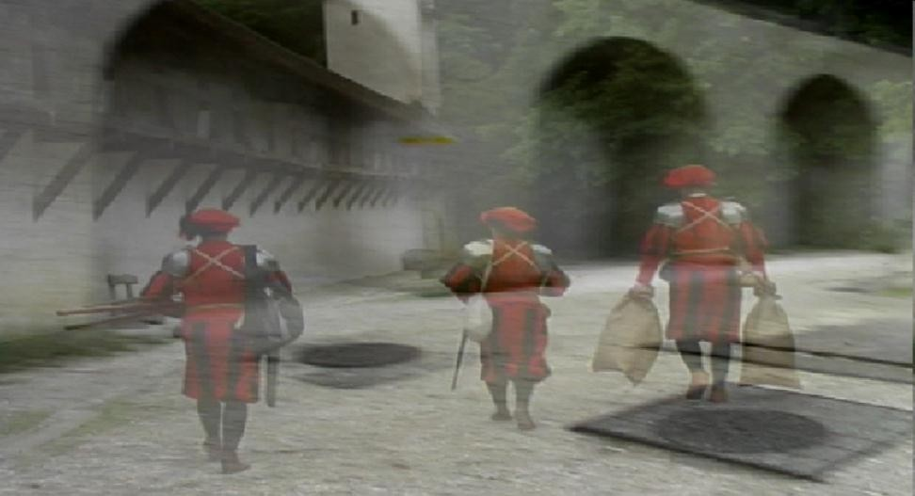
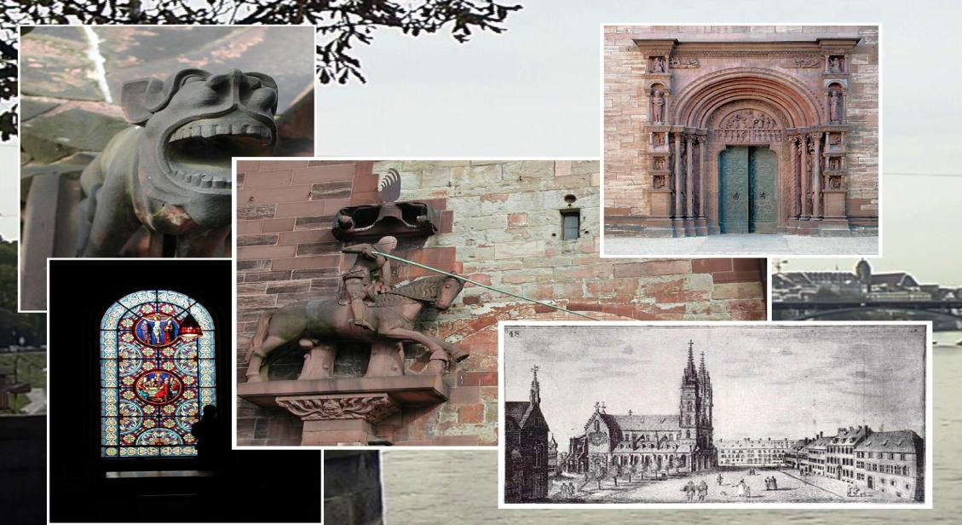
LifeClipper
LifeClipper is a wearable AR system being used in Switzerland.
When walking around a chosen culturally interesting area, the user will feel as though they are watching a film.

Slide 33
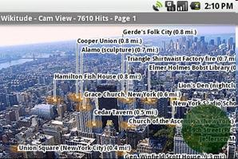
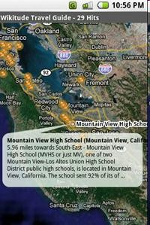
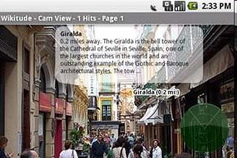
Wikitude – AR Travel Guide
Mobile travel guide for the Android platform (open source OS for cell phones).
Plan a trip or find about current surroundings in real- time.

Slide 34
Supplements:
How the human eye works
PPI vs. DPI: what's the difference?
Books & Resources:
https://drive.google.com/drive/folders/1PKGjHT_DGb4wNs-NTYjurEnndd-_Mrvr?usp=sharing

